Slide 1

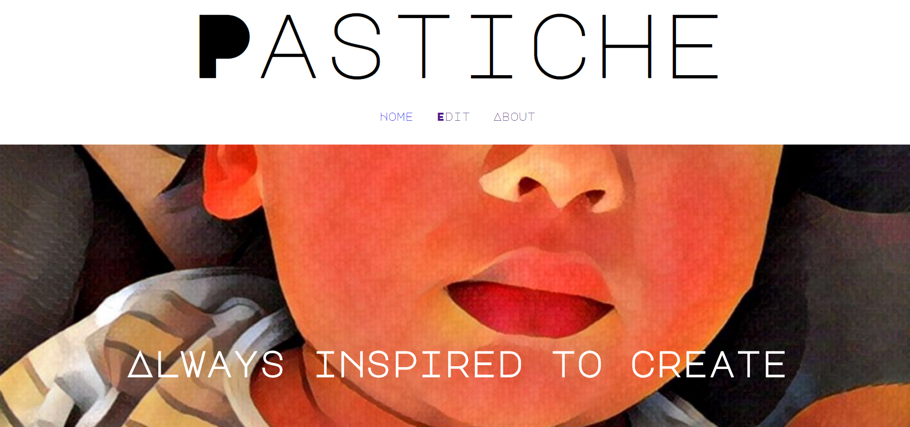

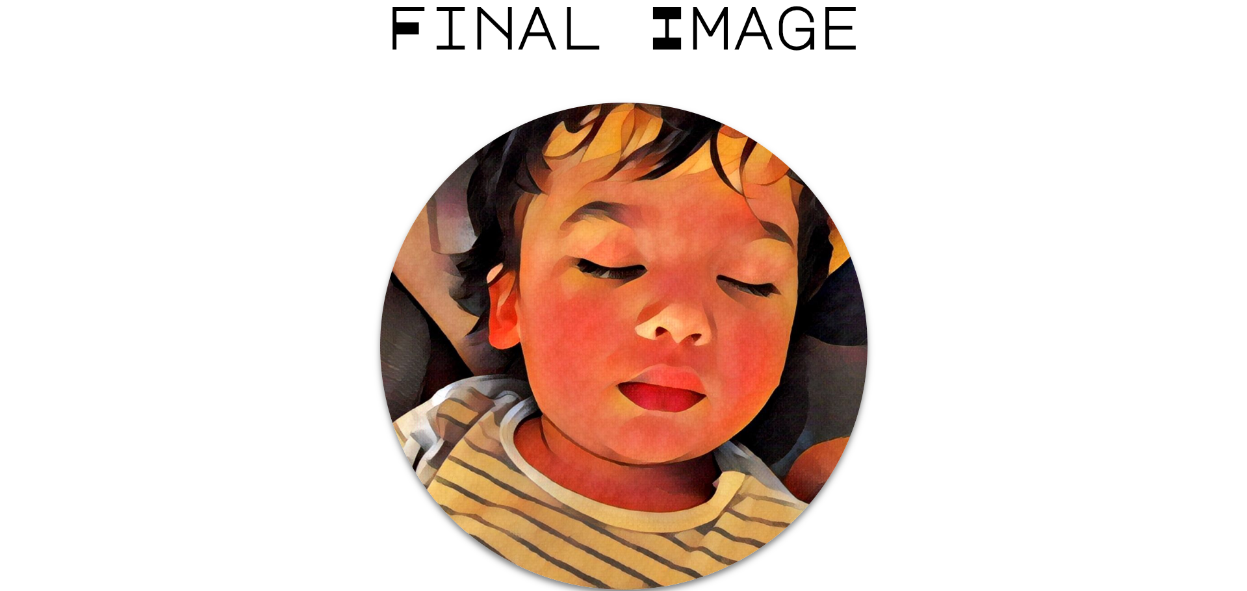

Taking styles you love into pictures
Adeline Wong ·Zhu Zhan Yan · Tracy Thun ka san

